Slide 1
Announcements
No CRCA classes on Monday, April 19th
International Fair/ Talent Show is Friday, April 23rd from 1-3:30
Prom is May 1st 7-10 PM at McKinney Roughs for Juniors and Seniors. Tickets are $35 for CRCA students and $40 for guests.
Senior Check Out Day is scheduled for Friday, May 21st. This is the time to bring in your laptops and textbooks, clean your lockers, get your final transcripts, eat Schlotzsky’s, etc.

Slide 2
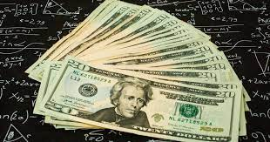
Loans, Loans, Loans
Terms to Know:
Grace Period- the amount of time after you graduate to start repaying your loan, usually 6 months. In some cases, interest will accumulate during this time.
Consolidation- combining all your student loans into one monthly payment. This can only be done one time. Many times this can save you money if consolidated under a lower interest rate.

Slide 3
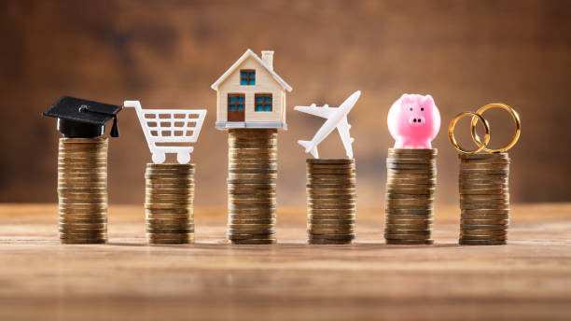
Loans, Loans, Loans
Repayment Options:
Standard- Payments are the same every month
Graduated- Payments start small and gradually increase (good if you don’t get a high paying job right out of college, but expect to make more soon ex. Doctor, IT, owning your own business)
Income-Sensitive- Payments are a percentage of your monthly income (good if you have a good career, but probably will not make a lot of money ex. Teacher)
Extended- Payments extend over 25 years instead of 20.

Slide 4
Debit Cards
Debit cards are tied directly to your checking account. You can only spend as much as you have in the bank. ex if you have $2,000, you will not be able to purchase a tv for $2,500.
This is good because you do not have to pay interest and cannot over purchase.
Debit cards, however, offer no rewards and do not build your credit score.

Slide 5
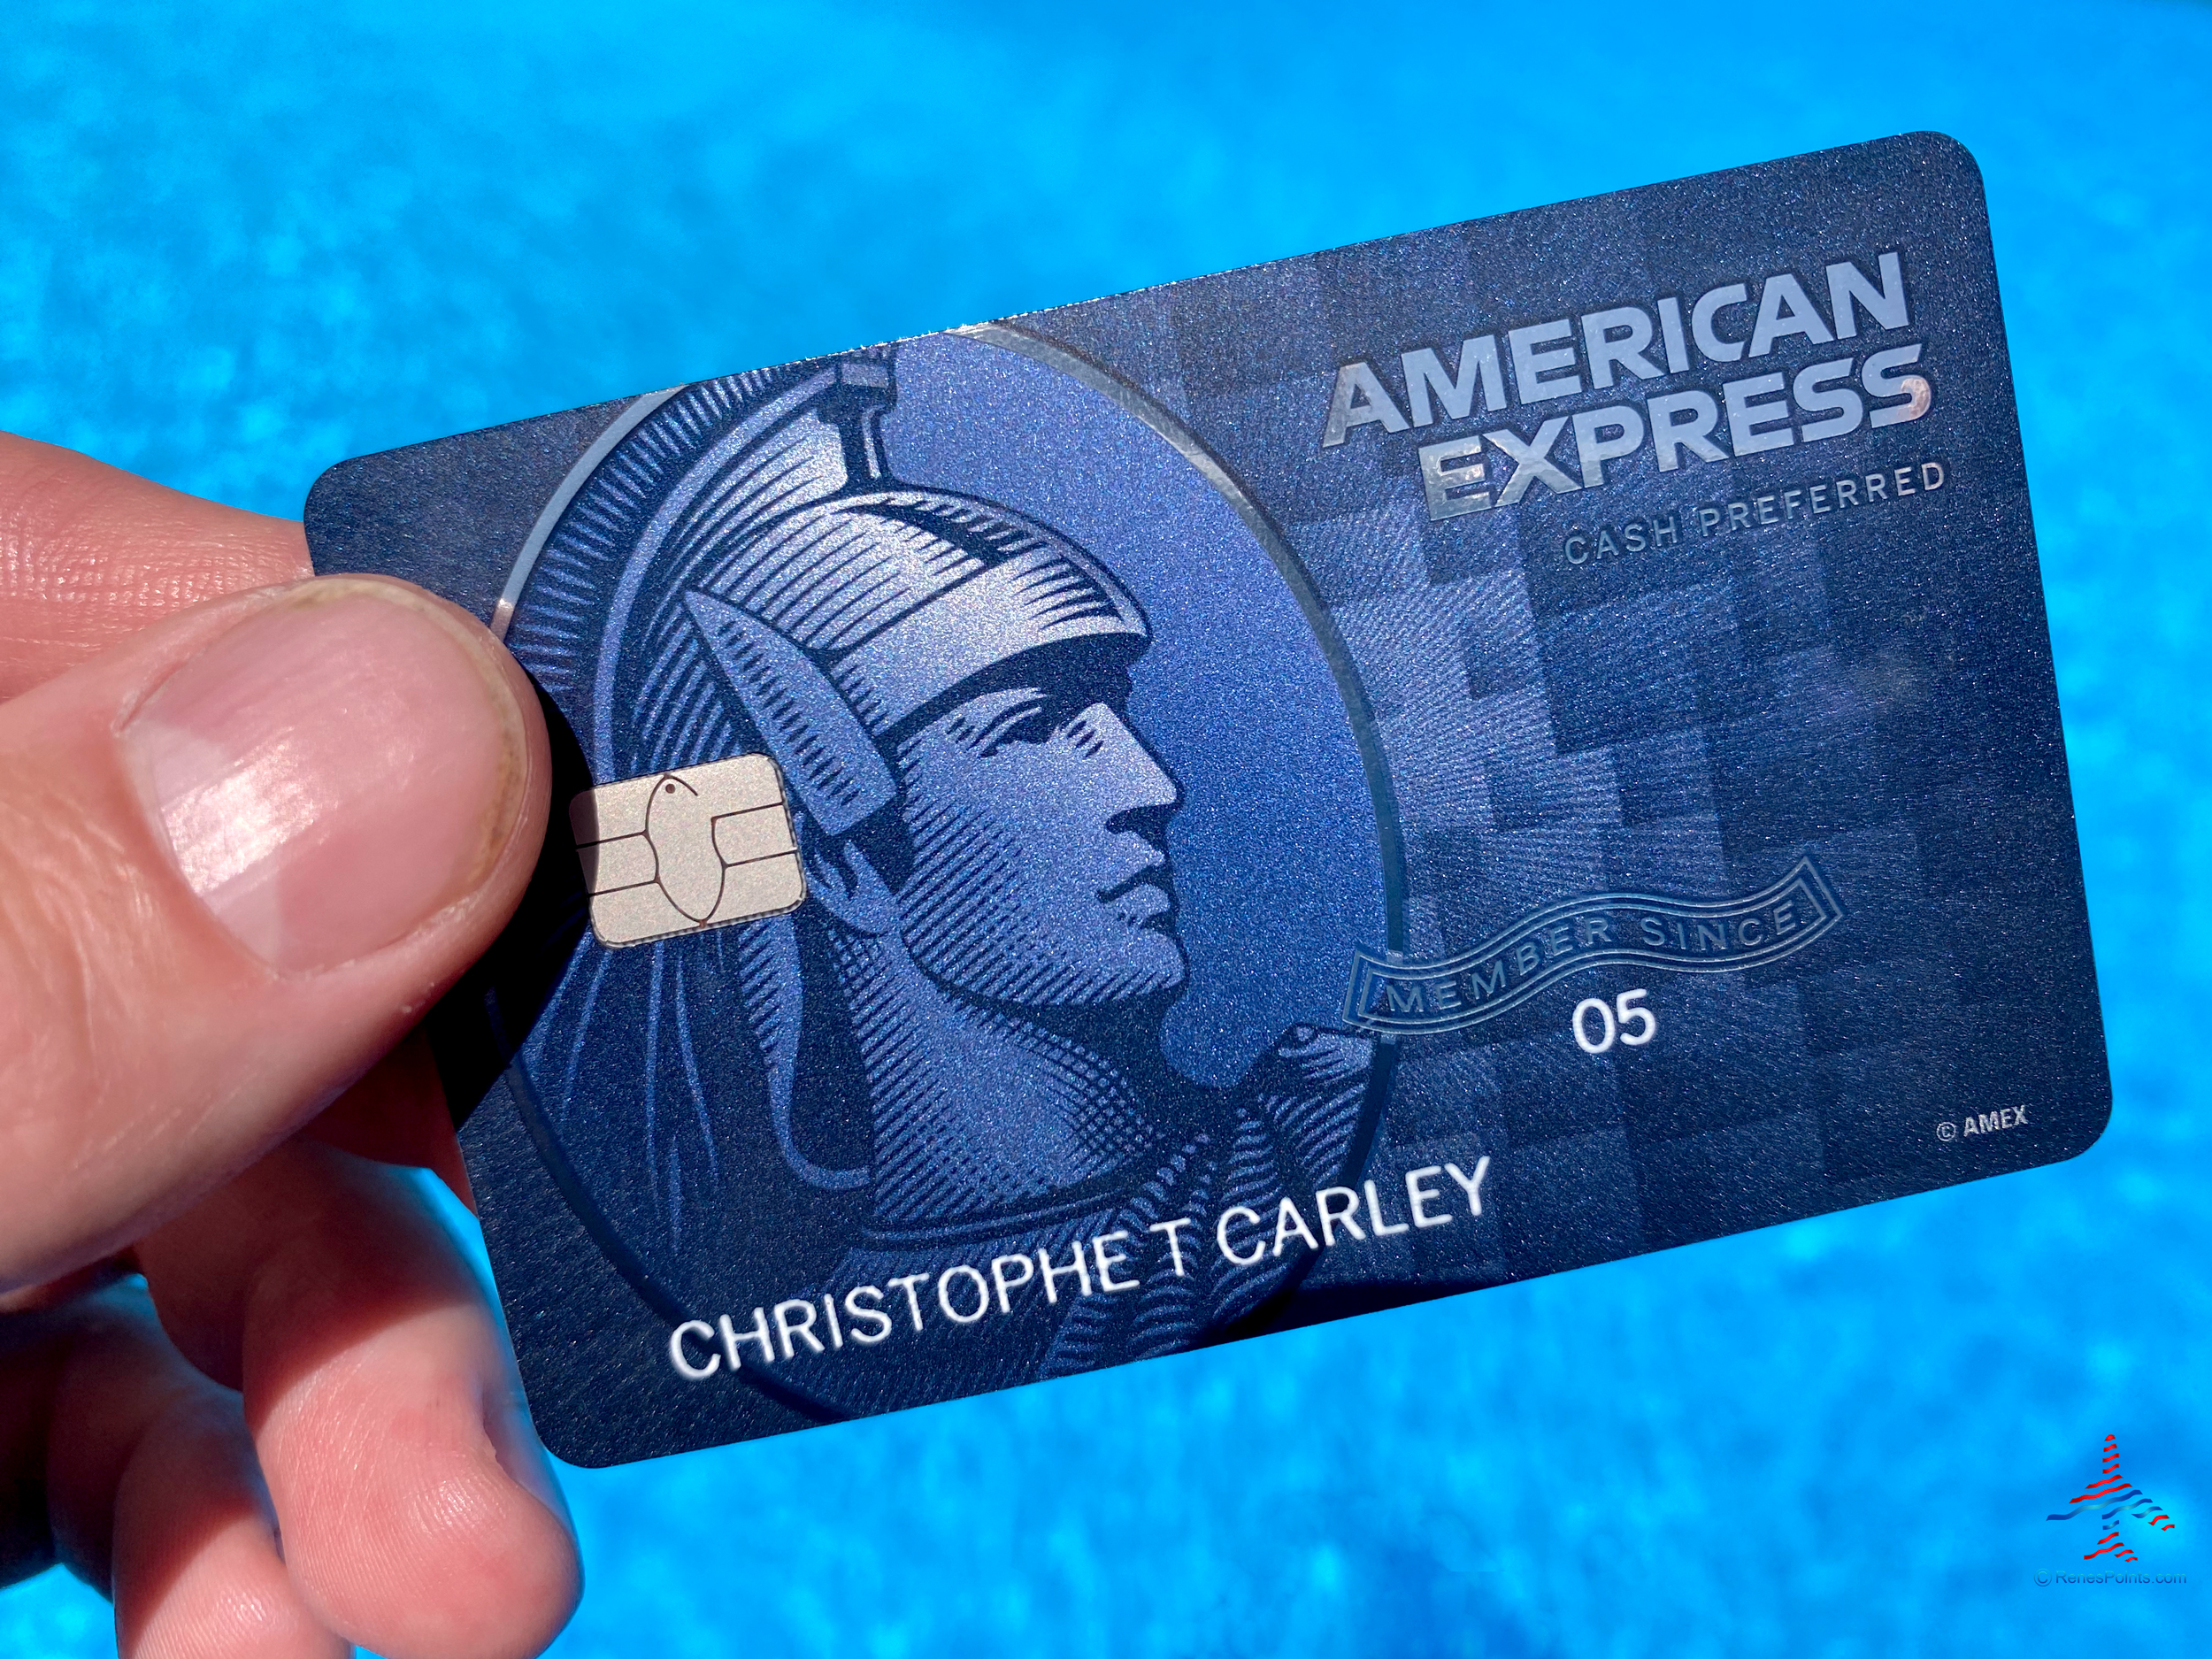
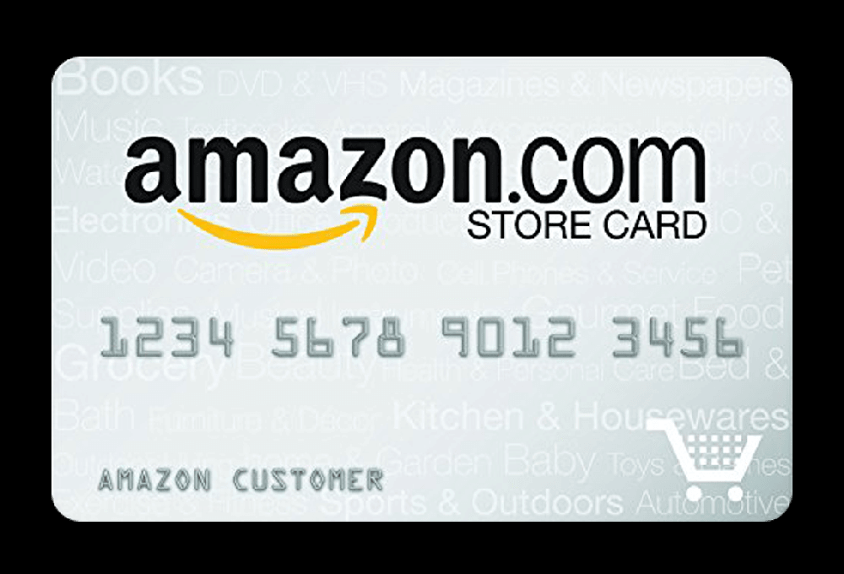
Credit Cards
Mr. Gordon’s 2 credit cards
Credit cards typically charge a very high interest rate,
average is 18%.
Many people carry large balances and only pay the minimum amount, instead of the full balance. This will end up costing you a lot in the end.
If used wisely, credit cards can be beneficial.
(I did not have a credit card until my 30’s but this is highly unusual.)

Slide 6
Credit Cards
Mr. Gordon’s 2 credit cards
Benefits of a Credit Card:
Build your credit score for future purchases such as a car or house
Rewards
Money back Ex Am. Ex Blue Card 6% on groceries, Amazon 5% back on Amazon purchases
Frequent Flyer Miles

Slide 7
Credit Cards
Credit Cards can be good as long as you pay the full balance every month.

